Slide 1

K-Mean Clustering Algorithm
Aksadur Rahman
aksadur@yahoo.com

Slide 2
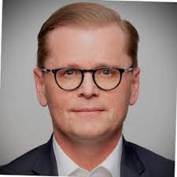
James MacQueen

Slide 3
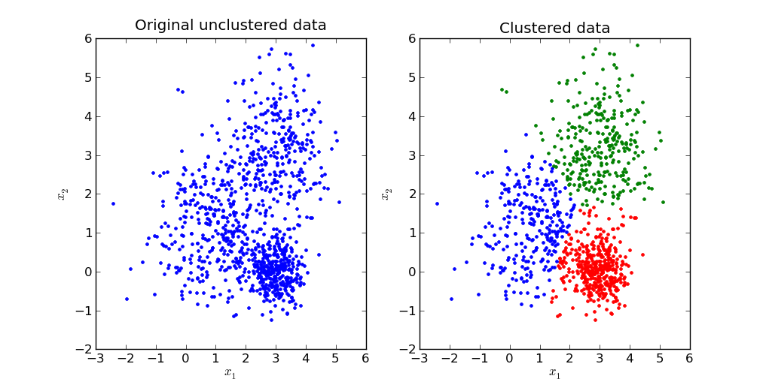
K-Mean Clustering Algorithm
k-means is one of the simplest unsupervised learning algorithms that solves the well-known clustering problem. The procedure follows a simple and easy way to classify a given data set through a certain number of clusters (assume k clusters)

Slide 4
K-Mean Clustering Algorithm
Problem
Divide the following data into two clusters using the k-mean clustering.
A(3,4) B(6,7) C(4,5), D(5,7) E(2,6)
Answer:
Initial Step: (Centroid selection)
For cluster-1: A(3, 4)
For cluster-2: C(4, 5)

Slide 5
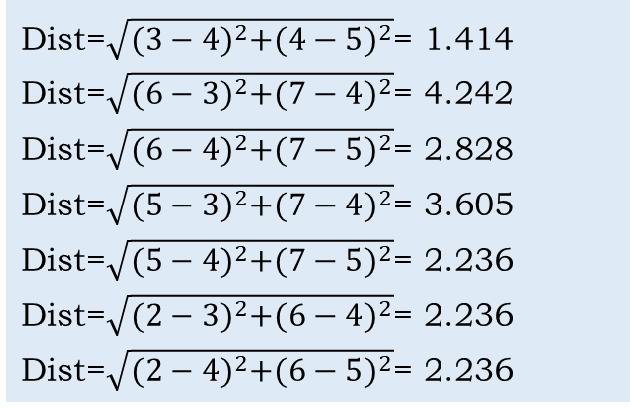
K-Mean Clustering Algorithm
Iteration -1
Side note
Data | Cluster-1 Centroid(3,4) | Cluster-2 Centroid(4,5) | Cluster
A(3,4) | 0 | 1.414 | Cluster-1
B(6,7) | 4.242 | 2.828 | Cluster-2
C(4,5) | 1.414 | 0 | Cluster-2
D(5,7) | 3.605 | 2.236 | Cluster-2
E(2,6) | 2.236 | 2.236 | Cluster-1
Dist=$\sqrt{{(3−4)}^{2}+{(4−5)}^{2}}$= 1.414
Dist=$\sqrt{{(6−3)}^{2}+{(7−4)}^{2}}$= 4.242
Dist=$\sqrt{{(6−4)}^{2}+{(7−5)}^{2}}$= 2.828
Dist=$\sqrt{{(5−3)}^{2}+{(7−4)}^{2}}$= 3.605
Dist=$\sqrt{{(5−4)}^{2}+{(7−5)}^{2}}$= 2.236
Dist=$\sqrt{{(2−3)}^{2}+{(6−4)}^{2}}$= 2.236
Dist=$\sqrt{{(2−4)}^{2}+{(6−5)}^{2}}$= 2.236

Slide 6
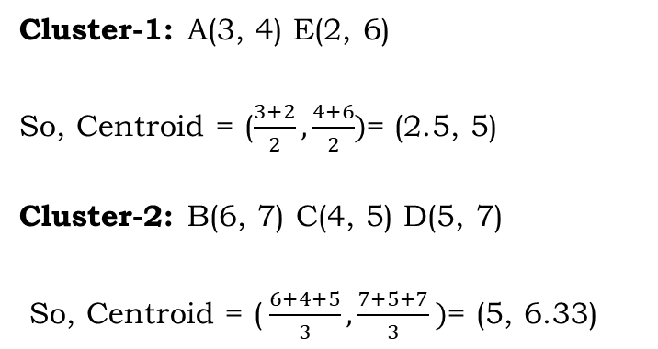
K-Mean Clustering Algorithm
Centroid Modification:
Cluster-1: A(3, 4) E(2, 6)
So, Centroid = ($\frac{3+2}{2}, \frac{4+6}{2})$= (2.5, 5)
Cluster-2: B(6, 7) C(4, 5) D(5, 7)
So, Centroid = ($\frac{6+4+5}{3}, \frac{7+5+7}{3} )$= (5, 6.33)

Slide 7
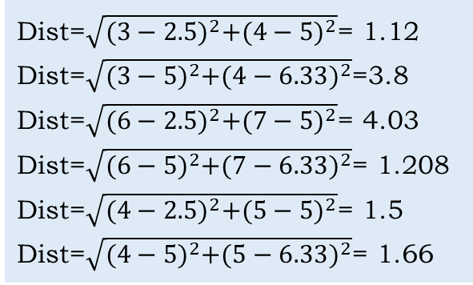
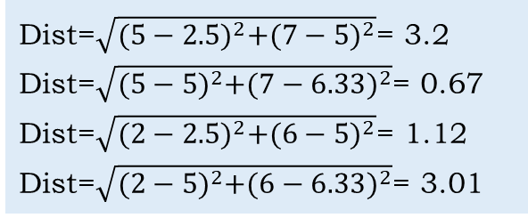
K-Mean Clustering Algorithm
Side note
Dist=$\sqrt{{(3−2.5)}^{2}+{(4−5)}^{2}}$= 1.12
Dist=$\sqrt{{(3−5)}^{2}+{(4−6.33)}^{2}}$=3.8
Dist=$\sqrt{{(6−2.5)}^{2}+{(7−5)}^{2}}$= 4.03
Dist=$\sqrt{{(6−5)}^{2}+{(7−6.33)}^{2}}$= 1.208
Dist=$\sqrt{{(4−2.5)}^{2}+{(5−5)}^{2}}$= 1.5
Dist=$\sqrt{{(4−5)}^{2}+{(5−6.33)}^{2}}$= 1.66
Iteration -2
Data | Cluster-1 Centroid(2.5,5) | Cluster-2 Centroid(5,6.33) | Cluster
A(3,4) | 1.12 | 3.8 | Cluster-1
B(6,7) | 4.03 | 1.208 | Cluster-2
C(4,5) | 1.5 | 1.66 | Cluster-1
D(5,7) | 3.2 | 0.67 | Cluster-2
E(2,6) | 1.12 | 3.01 | Cluster-1
Dist=$\sqrt{{(5−2.5)}^{2}+{(7−5)}^{2}}$= 3.2
Dist=$\sqrt{{(5−5)}^{2}+{(7−6.33)}^{2}}$= 0.67
Dist=$\sqrt{{(2−2.5)}^{2}+{(6−5)}^{2}}$= 1.12
Dist=$\sqrt{{(2−5)}^{2}+{(6−6.33)}^{2}}$= 3.01

Slide 8
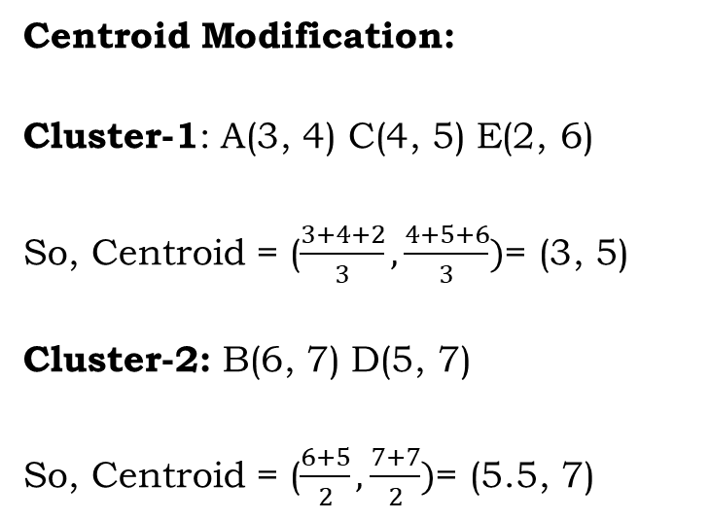
K-Mean Clustering Algorithm
Centroid Modification:
Cluster-1: A(3, 4) C(4, 5) E(2, 6)
So, Centroid = ($\frac{3+4+2}{3}, \frac{4+5+6}{3})$= (3, 5)
Cluster-2: B(6, 7) D(5, 7)
So, Centroid = ($\frac{6+5}{2}, \frac{7+7}{2})$= (5.5, 7)

Slide 9
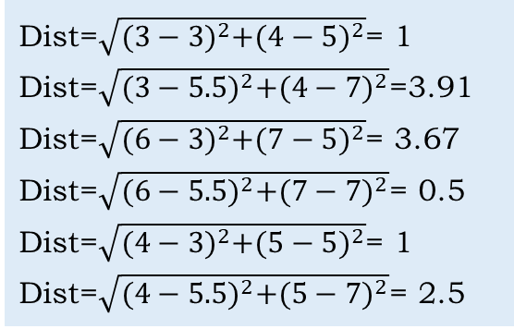
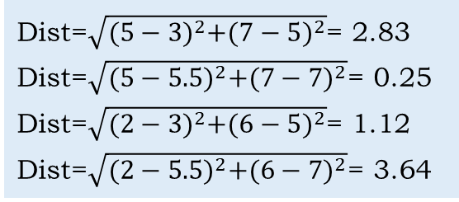
K-Mean Clustering Algorithm
Side note
Dist=$\sqrt{{(3−3)}^{2}+{(4−5)}^{2}}$= 1
Dist=$\sqrt{{(3−5.5)}^{2}+{(4−7)}^{2}}$=3.91
Dist=$\sqrt{{(6−3)}^{2}+{(7−5)}^{2}}$= 3.67
Dist=$\sqrt{{(6−5.5)}^{2}+{(7−7)}^{2}}$= 0.5
Dist=$\sqrt{{(4−3)}^{2}+{(5−5)}^{2}}$= 1
Dist=$\sqrt{{(4−5.5)}^{2}+{(5−7)}^{2}}$= 2.5
Iteration -3
Data | Cluster-1 Centroid(3,5) | Cluster-2 Centroid(5.5, 7) | Cluster
A(3,4) | 1 | 3.91 | Cluster-1
B(6,7) | 3.67 | 0.5 | Cluster-2
C(4,5) | 1 | 2.5 | Cluster-1
D(5,7) | 2.83 | 0.25 | Cluster-2
E(2,6) | 1.12 | 3.64 | Cluster-1
Dist=$\sqrt{{(5−3)}^{2}+{(7−5)}^{2}}$= 2.83
Dist=$\sqrt{{(5−5.5)}^{2}+{(7−7)}^{2}}$= 0.25
Dist=$\sqrt{{(2−3)}^{2}+{(6−5)}^{2}}$= 1.12
Dist=$\sqrt{{(2−5.5)}^{2}+{(6−7)}^{2}}$= 3.64

Slide 10
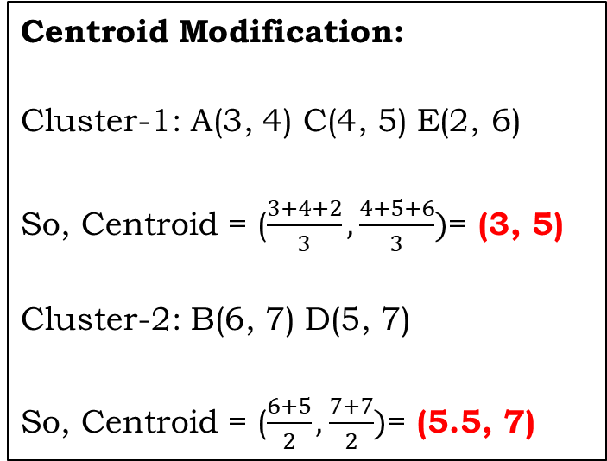
K-Mean Clustering Algorithm
Centroid Modification:
Cluster-1: A(3, 4) C(4, 5) E(2, 6)
So, Centroid = ($\frac{3+4+2}{3}, \frac{4+5+6}{3})$= (3, 5)
Cluster-2: B(6, 7) D(5, 7)
So, Centroid = ($\frac{6+5}{2}, \frac{7+7}{2})$= (5.5, 7)
Final Output
Data | Cluster | Centroid
A(3,4) C(4,5) E(2,6) | Cluster-1 | (3,5)
B(6,7) D(5,7) | Cluster-2 | (5.5, 7)

Slide 11
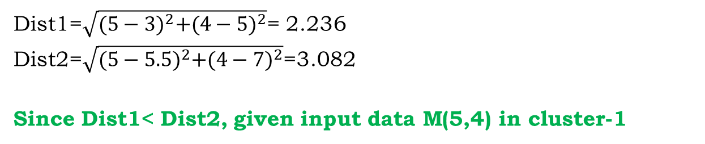
K-Mean Clustering Algorithm
Problem
Decide which cluster contain the input data M(5,4)
Answer:
Dist1=$\sqrt{{(5−3)}^{2}+{(4−5)}^{2}}$= 2.236
Dist2=$\sqrt{{(5−5.5)}^{2}+{(4−7)}^{2}}$=3.082
Since Dist1< Dist2, given input data M(5,4) in cluster-1

Slide 12
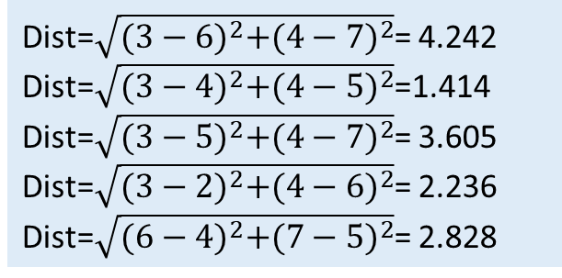
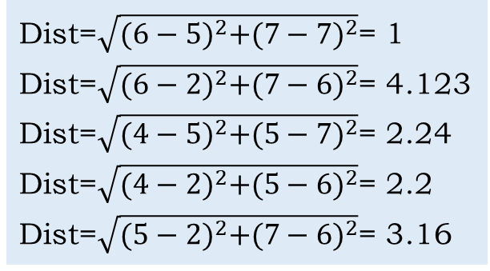
Modified K-Mean Clustering Algorithm
Side Note
Dist=$\sqrt{{(3−6)}^{2}+{(4−7)}^{2}}$= 4.242
Dist=$\sqrt{{(3−4)}^{2}+{(4−5)}^{2}}$=1.414
Dist=$\sqrt{{(3−5)}^{2}+{(4−7)}^{2}}$= 3.605
Dist=$\sqrt{{(3−2)}^{2}+{(4−6)}^{2}}$= 2.236
Dist=$\sqrt{{(6−4)}^{2}+{(7−5)}^{2}}$= 2.828
Centroid Selection
Data | A(3,4) | B(6,7) | C(4,5) | D(5,7) | E(2,6)
A(3,4) | 0 | 4.242 | 1.414 | 3.605 | 2.236
B(6,7) |  | 0 | 2.828 | 1 | 4.123
C(4,5) |  |  | 0 | 2.24 | 2.2
D(5,7) |  |  |  | 0 | 3.16
E(2,6) |  |  |  |  | 0
Dist=$\sqrt{{(6−5)}^{2}+{(7−7)}^{2}}$= 1
Dist=$\sqrt{{(6−2)}^{2}+{(7−6)}^{2}}$= 4.123
Dist=$\sqrt{{(4−5)}^{2}+{(5−7)}^{2}}$= 2.24
Dist=$\sqrt{{(4−2)}^{2}+{(5−6)}^{2}}$= 2.2
Dist=$\sqrt{{(5−2)}^{2}+{(7−6)}^{2}}$= 3.16
So, Initial centroid
For Cluster 1: (3, 4)
For Cluster 2: (6, 7)

